Slide 1

Airline Reservation system design
CS 1103 Project
Domenica Vasco - 3772200

Slide 2
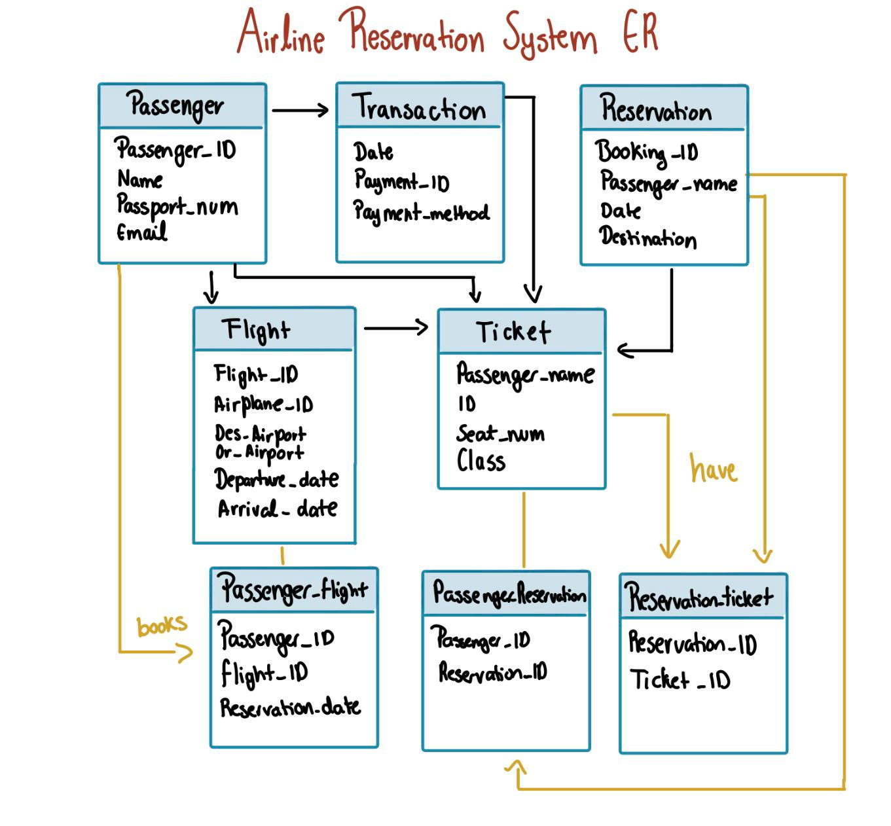
ER diagram:

Slide 3

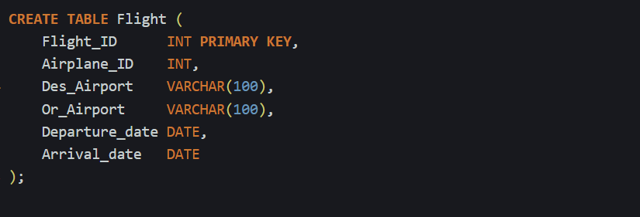

DDL statements for each entity:
Passenger_ID is my primary key
Transaction references Passenger via foreign key (every transaction must be linked to a real passenger)

Slide 4

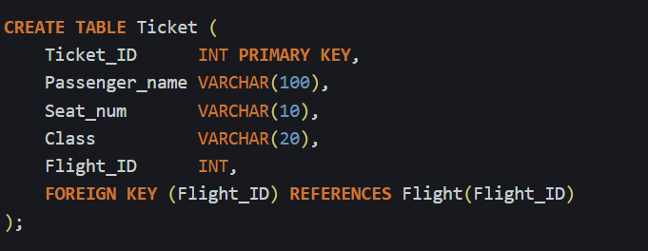
DDL statements for each entity:

Slide 5

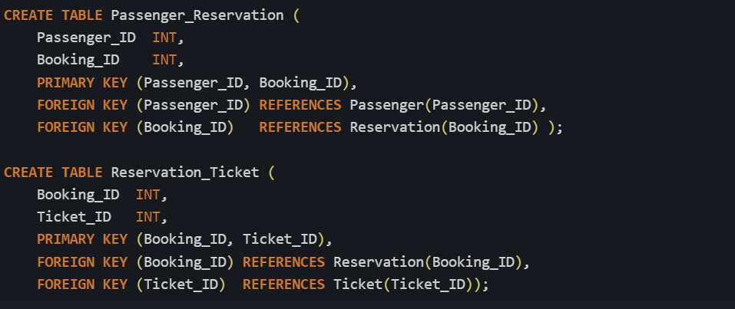
DDL Relationships:

Slide 6
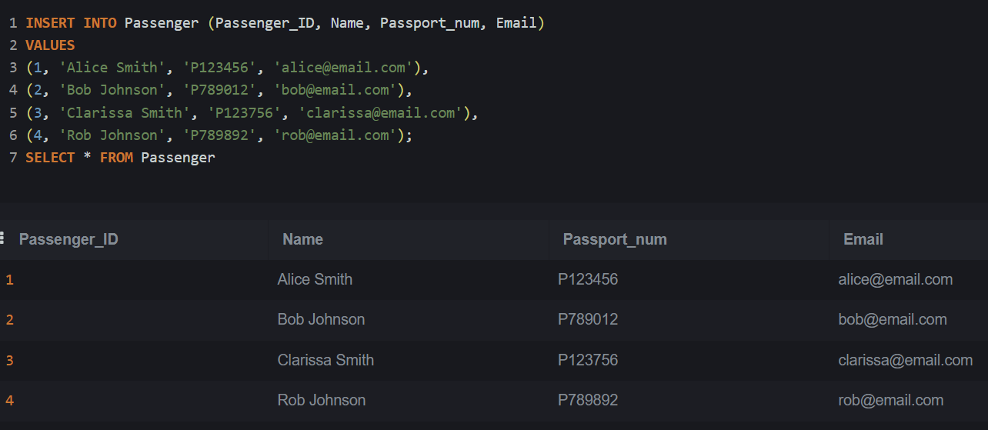
Insert statements:

Slide 7
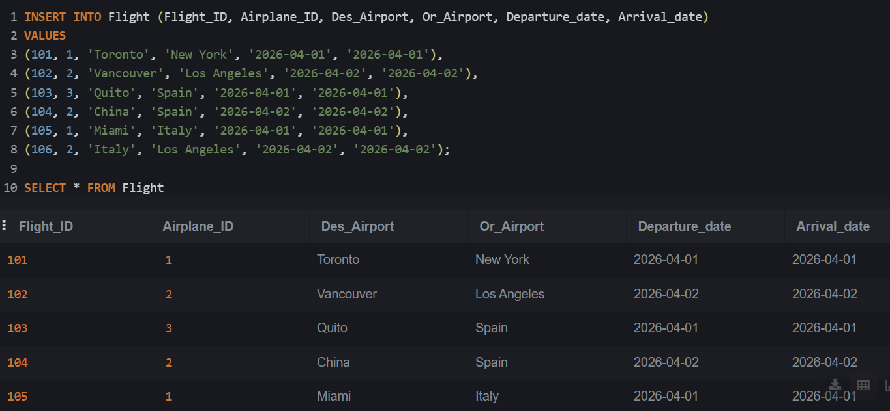
Insert statements:

Slide 8
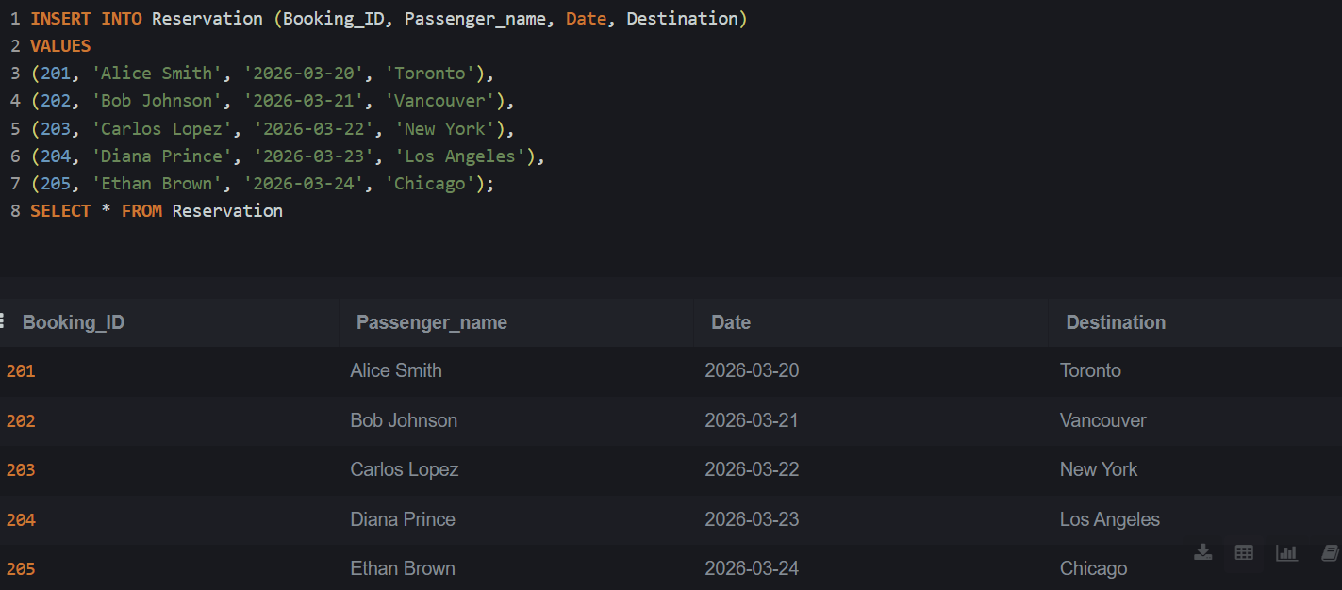
Insert statements:

Slide 9
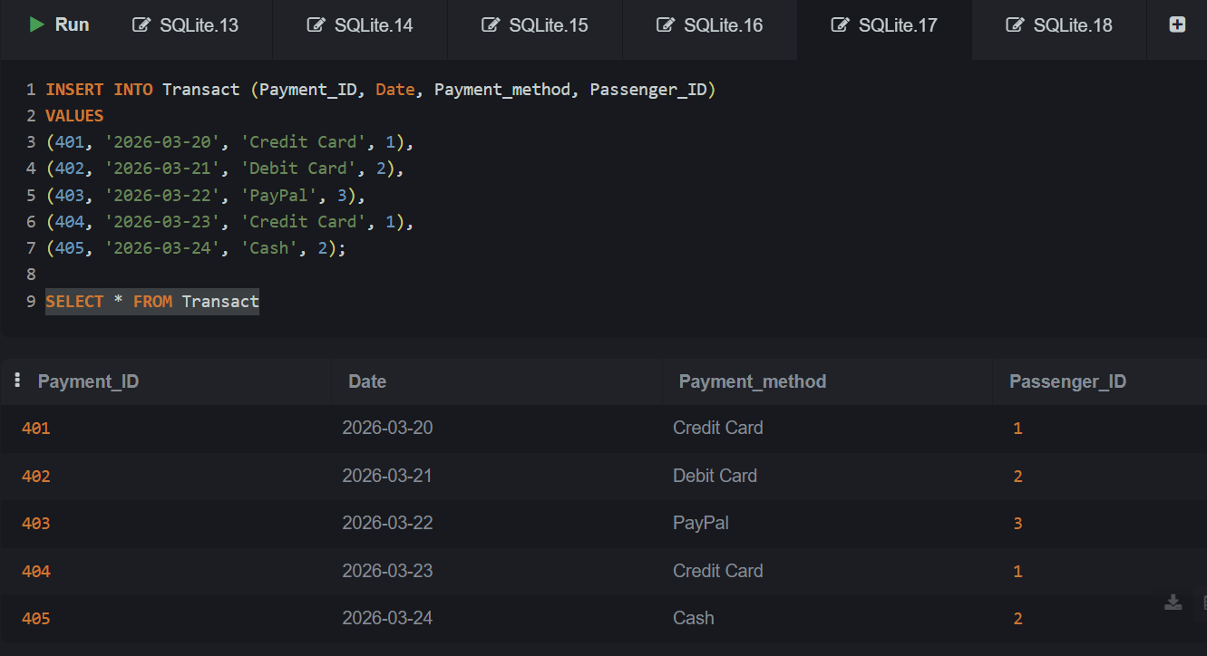
Insert statements:

Slide 10
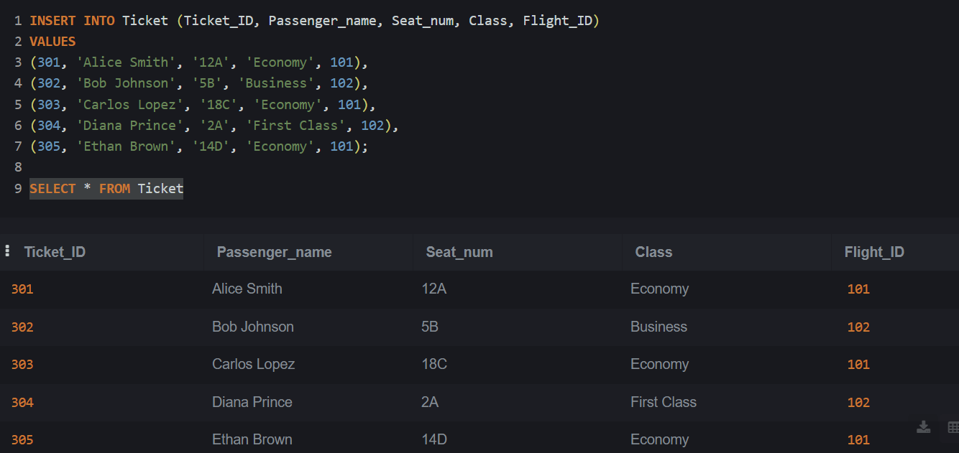
Insert statements:

Slide 11
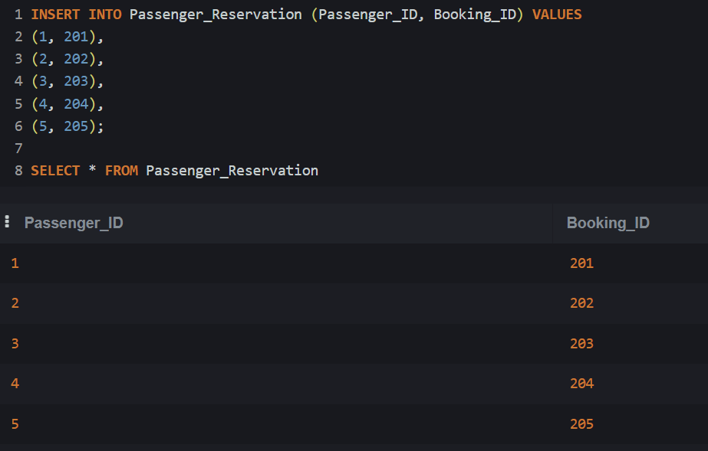
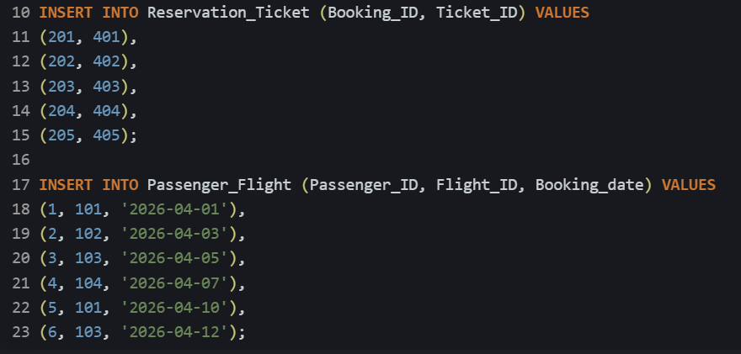
Insert statements (relationship):

Slide 12
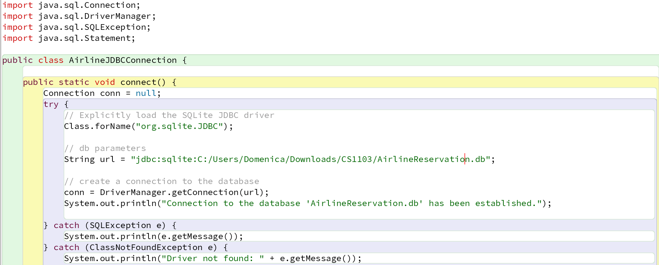

JDBC connection:

Slide 13
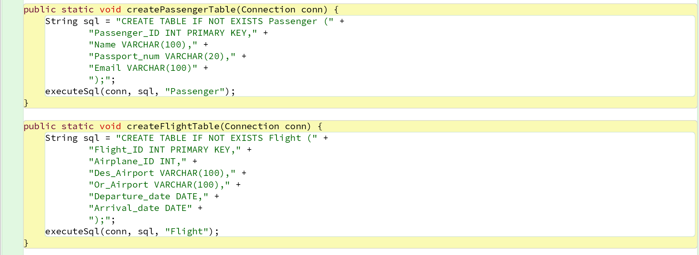
database schema using JDBC:

Slide 14
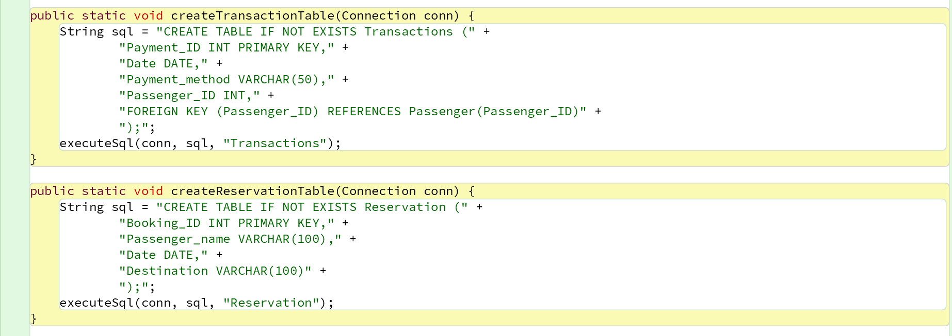
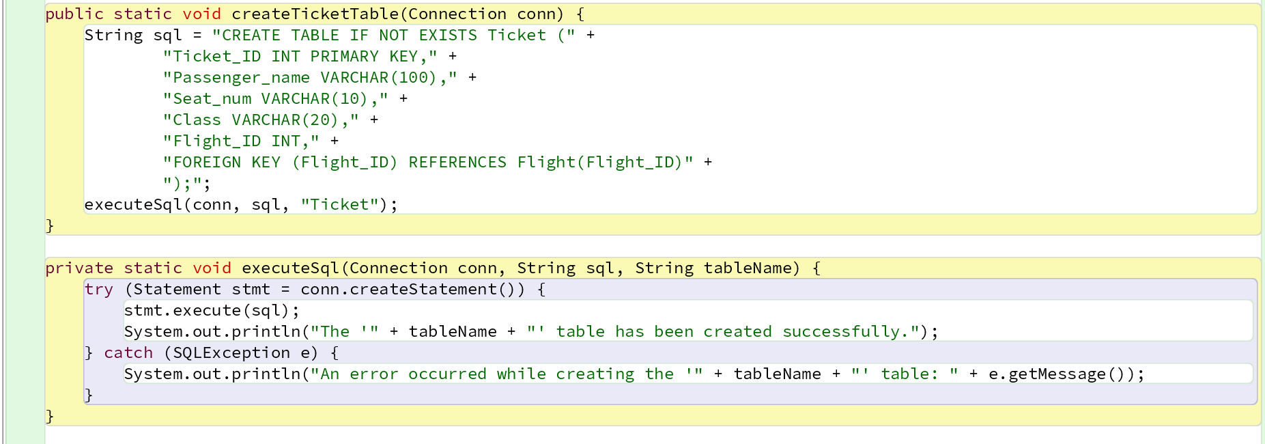
database schema using JDBC:

Slide 15

oUTPUT:

Slide 16
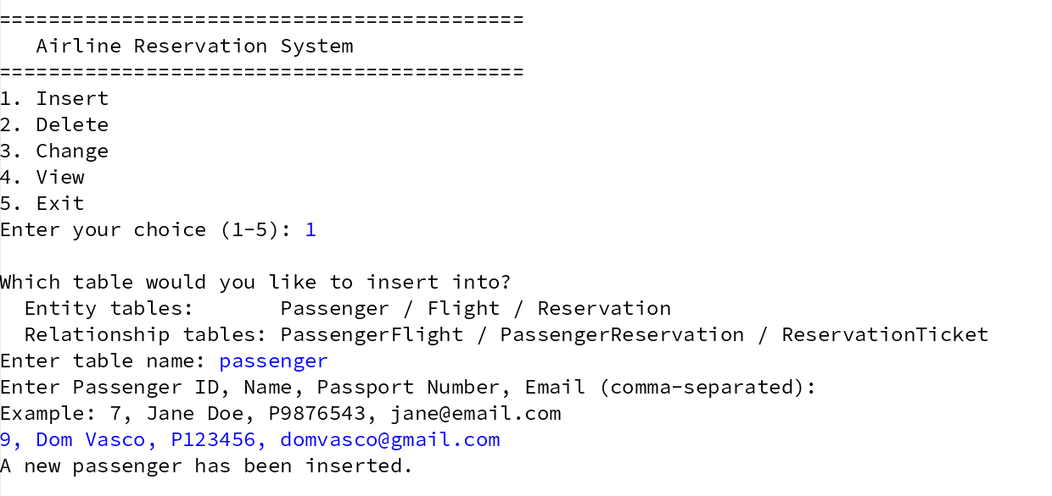
My application

Slide 17
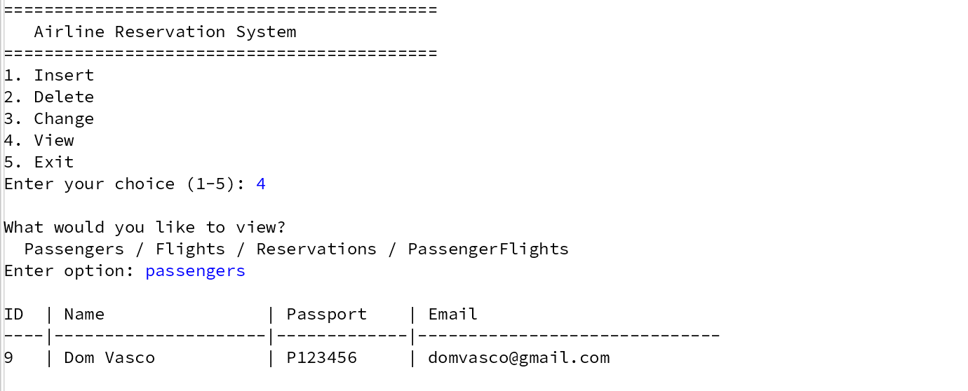
My application

Slide 18
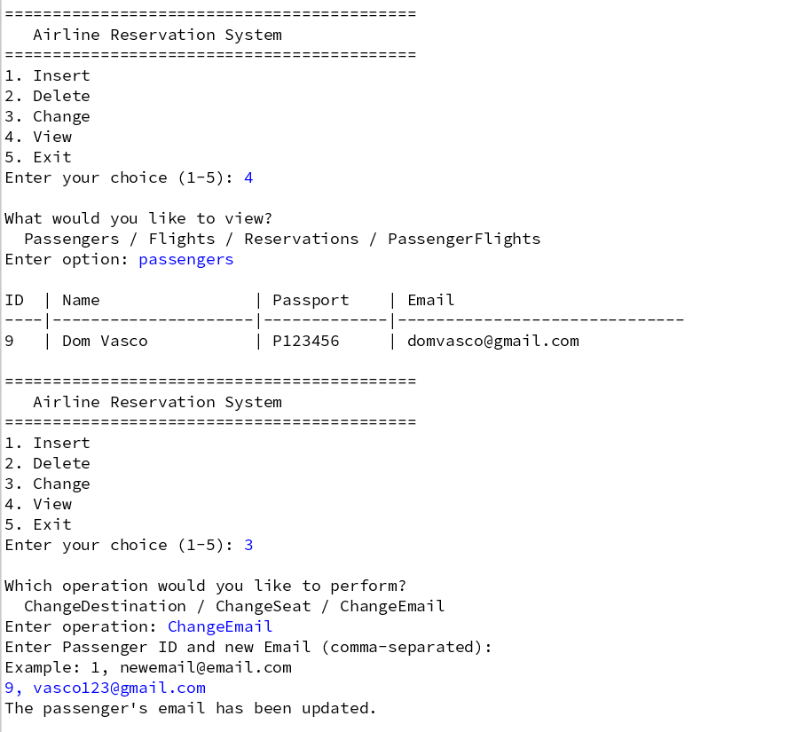
My application
I added some methods that will
update (change) a passengers’
seat, destination, or email.

Slide 19
THANK YOU!

